Slide 1


Digital Transformation in Healthcare
Presented by: Group 15
Ambarish Tirumalai (23201747)
Bishal Ghosh (23200342)
Stebin Sebastian (23200018)
Thapanee Sasuwan (23201498)

Slide 2
Introduction
Irish Healthcare stands at a critical juncture: to serve the people, it needs to
integrate the current fragmented system into a unified one. One of the ways that it
can be achieved to triage resource allocation through machine learning.
Empowering Stakeholders
Patients: Immediate gains in personalised, timely care
Healthcare professionals: Enhanced decision-making, decreasing administrative load
Health Service Executive (HSE): Optimised resource distribution, improved care quality
Health Insurance Provider: Risk management, Persoanlised insurance plans and faster claims
Objectives
Resource Management: Implement ML to refine hospital resource allocation, aligning bed availability and staffing to demand
Patient Triage: Integrate AI systems to evaluate initial symptoms, directing patients accurately at the start of their healthcare journey (common diseases)

Slide 3

Study Scope
01
02
03
Hospital admission
Chronic diseases
Cancers
Categorisation between OPD and emergency admissions
Forecasting admission number of patient for next 3 months
Diabetes
Kidney
Heart
Colon
Leukaemia
Prostate
Breast
Lung

Slide 4

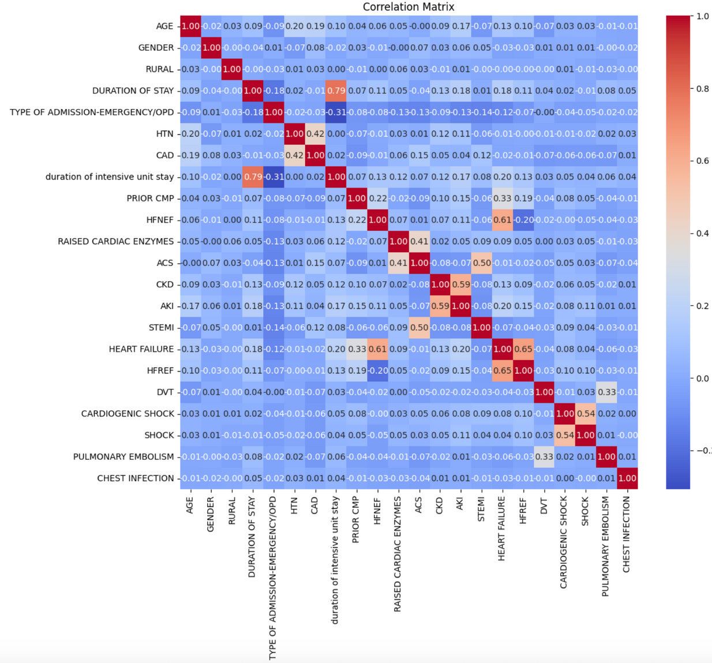
Hospital Admission
Model selection
Logistic Regression: Handles continuous and categorical data, interpretable results (easier to understand which factors influence prediction), computationally efficient.
Random Forest (RF): Combines multiple decision trees, trained on random data subsets with replacement and random feature subsets at splits.
Preprocessing
Using key features, after feature engineering, we used logistic regression to determine if a patient's case is Emergency or OPD. Similarly, using multivariate analysis between key features we used Random forest to get estimation of number of admissions for next 3 months.
Summary
The trained model achieved an accuracy of 81.22%, effectively predicting between emergency and OPD cases.
Considering patients with multiple admission, the predicted admission rate for randomly selected 2,000 patients is 84.65% over the next 3 months. However, the estimated percentage drops to 28.55% when taking into account the entire unfiltered data.

Slide 5
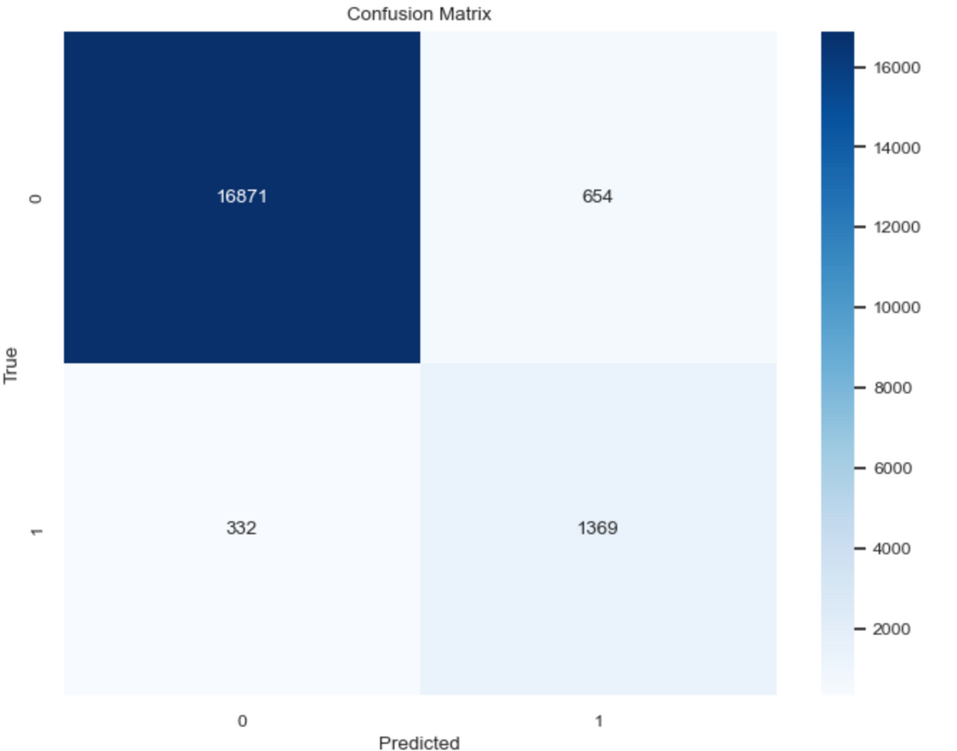
Chronic diseases - DIABETES
Model selection
Random Forest combine multiple decision trees, trained on random data subsets with replacement and random feature subsets at splits. Aggregating these trees' predictions improves overall accuracy.
Preprocessing
One-Hot Encoding effectively transforms categorical variables into numerical representations, ensuring the model can understand these features.
Standard Scalar is utilised to normalise all input features, ensuring a mean of 0 and standard deviation of 1. This creates a balanced data scale for machine learning models, regardless of imbalanced datasets.
Grid Search helps to optimise model by efficiently exploring a range of hyperparameter combinations to identify the settings that yield the best performance.
Accuracy | Recall | Precision | F1 score
95% | 0.80 | 0.68 | 0.74
Summary
To assess performance, the trained model was evaluated and achieved an accuracy of around 95%. This indicates the model effectively classified most cases.
The model reveals key factors influencing diabetes in our model. HbA1c (blood sugar control), blood glucose level, age, and BMI emerged as the most important features

Slide 6
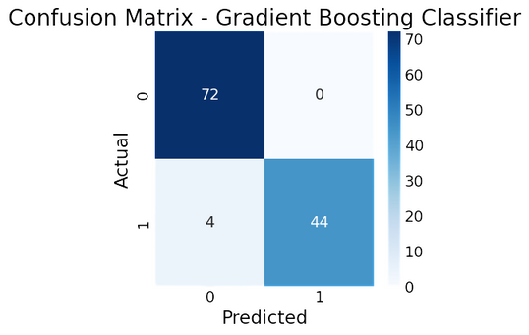
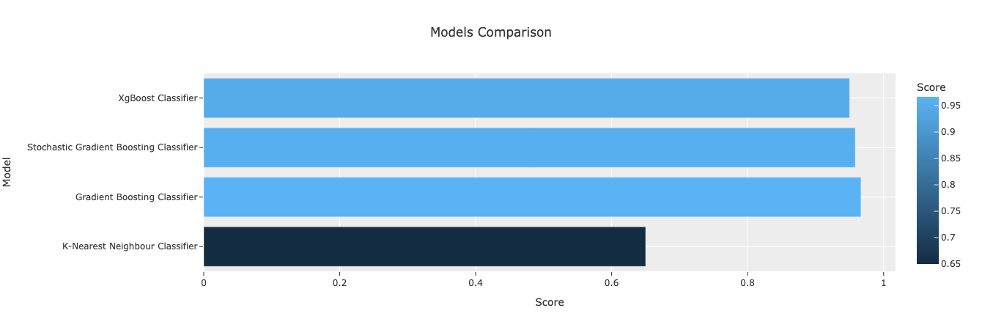
Chronic diseases -KIDNEY
Model selection:
Gradient Boosting (GB), XGBoost, Stochastic gradient boosting (SGB): Powerful for complex, non-linear relationships: Can capture intricate interactions between features that might influence kidney disease development.
K-Nearest Neighbors (KNN): a user-friendly choice for high-dimensional kidney disease prediction due to its minimal parameter tuning and ability to handle datasets with many features.
Preprocessing
Label Encoder is used transforming categorical data into numerical labels for machine learning algorithms.
Summary
Aside from KNN, most models excelled in kidney disease detection, achieving accuracy above 95%. Analyzing precision, recall, and F1-score (all exceeding 90%), we see strong performance in identifying healthy individuals. This suggests the models correctly classified a high percentage of healthy cases.

Slide 7
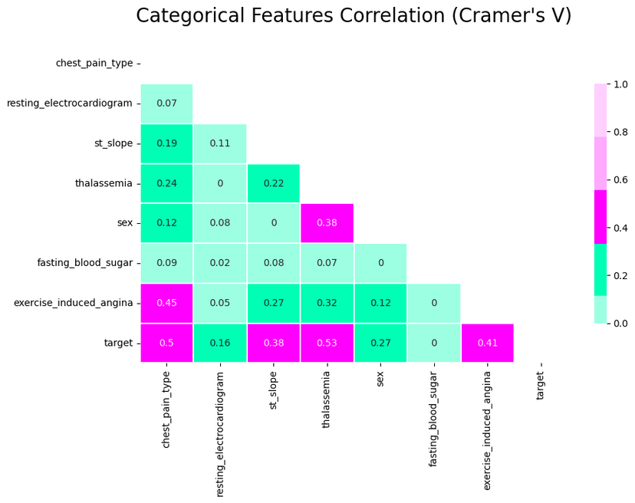
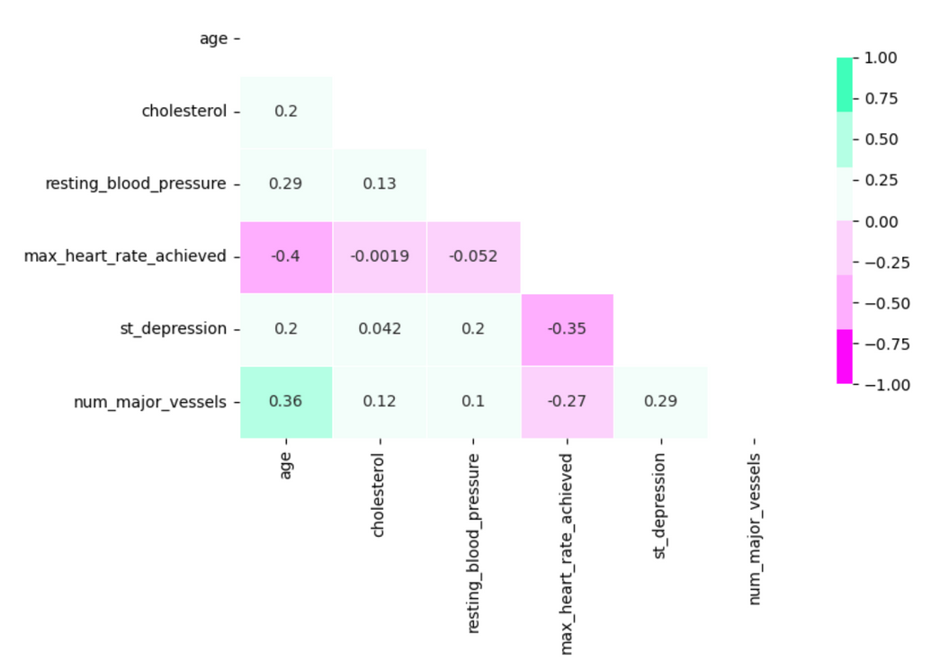
Chronic diseases - HEART
Model selection:
Logistic Regression (LR)
Naive Bayes: Simple and efficient, works well with high-dimensional data (many features).
Linear Discrimination Analysis (LDA): Effective for well-separated classes in data, good interpretability.
Quadratic Discrimination Analysis (QDA): Can capture non-linear relationships between features and heart disease, potentially more accurate than LDA for complex data.
Preprocessing
Label Encoder is used transforming categorical data into numerical labels for machine learning algorithms.

Slide 8
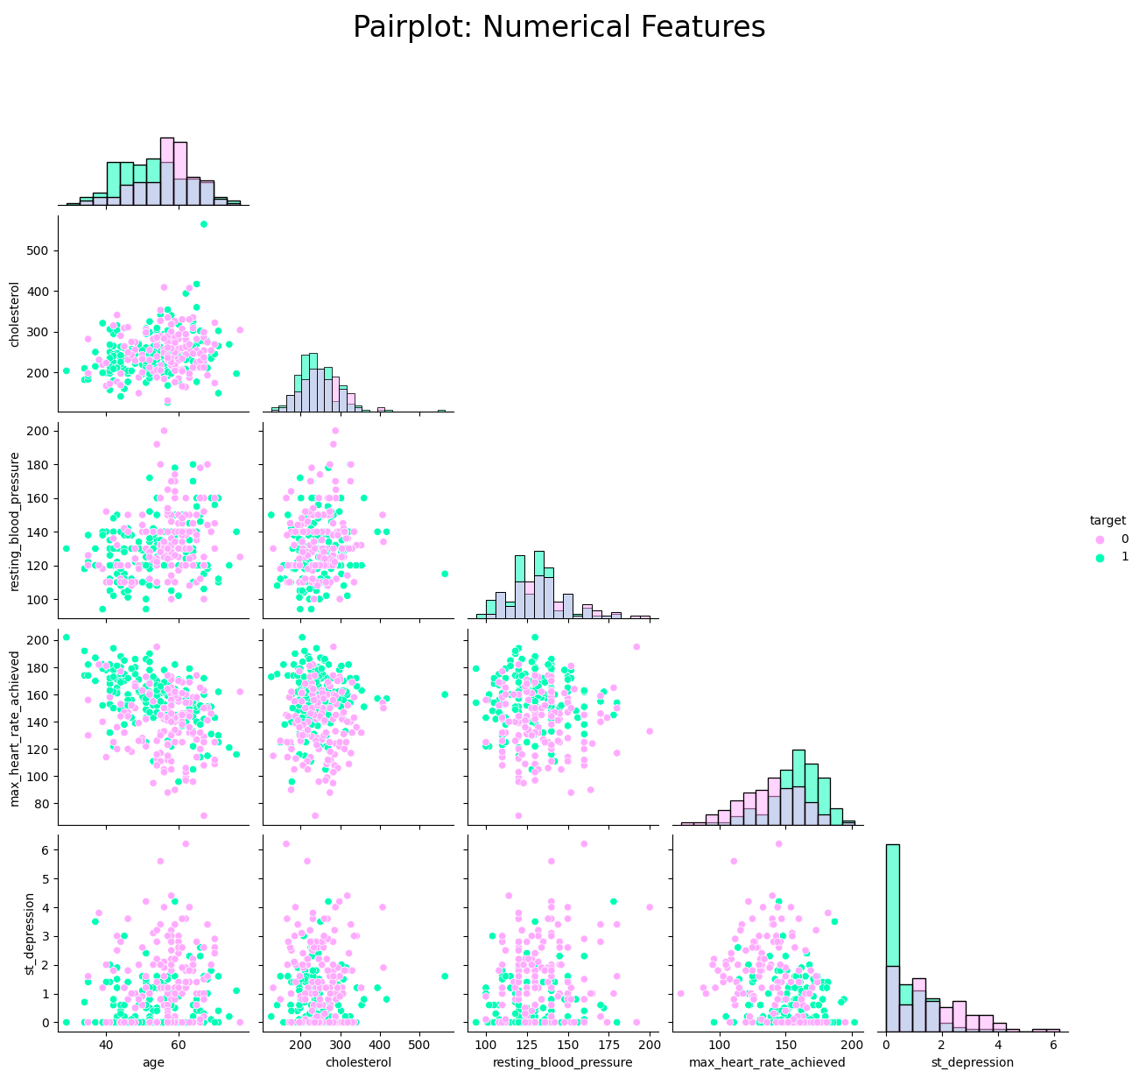
Comparison Result
 | Accuracy | Recall | Precision | F1 Score
Logistic Regression | 86% | 0.91 | 0.82 | 0.86
Linear DA | 85% | 0.89 | 0.82 | 0.85
Quadratic DA | 85% | 0.83 | 0.85 | 0.84
Naive Bayes | 82% | 0.86 | 0.79 | 0.82
Summary
Excluding Naive Bayes, most models achieved high accuracy (>85%) in detecting heart disease using features like chest pain type, major vessels involved, thalassemia, exercise with angina, max heart rate, and ST depression. Focusing on precision, Logistic Regression and Linear DA excelled with over 89% accuracy, indicating these models effectively ruled out heart disease in a significant portion of healthy cases.

Slide 9
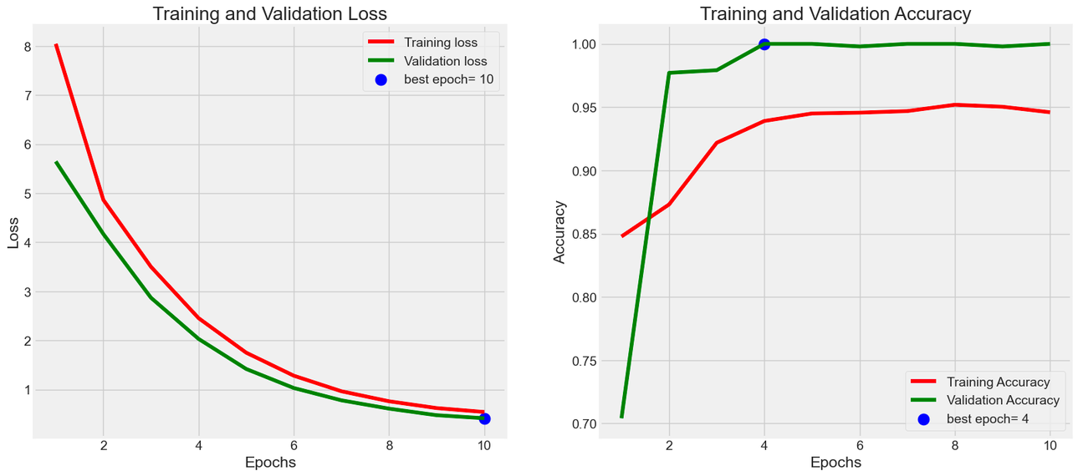
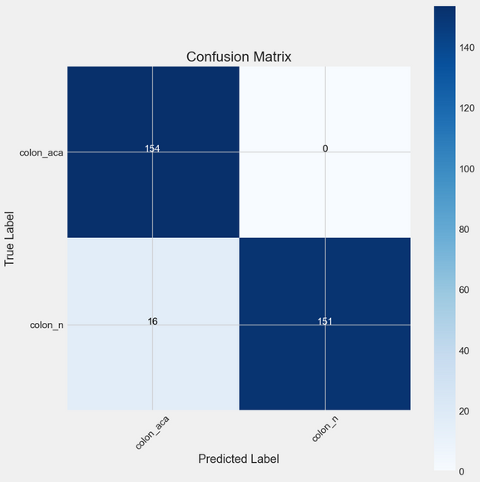
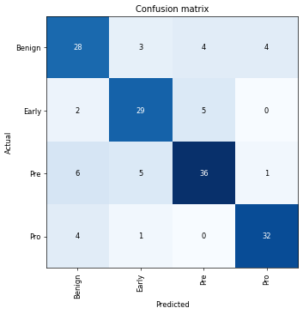
Cancers - COLON CANCER & LEUKAEMIA
Model Selection
EfficientNet - B3 is a convolutional neural network (CNN) built to train models on images, based on the concept called Compound Scaling. This concept addresses the tradeoff between three essential dimensions of a neural network: Width, Depth Resolution
Summary
The accuracies of both cancers are more than 85%, which shows that the EfficientNet - B3 model is very apt for analysing image-based data.
Preprocessing
Adamax is used where the gradients have high variability or sparse features are involved.
 | Accuracy | Recall | Precision | F1 score
Colon Cancer | 87.5% | 1.0 | 0.4167 | 0.5880
Leukaemia | 85.71% | 1.0 | 0.33 | 0.5
Colon Cancer Confusion Matrix
Leukemia Confusion Matrix

Slide 10
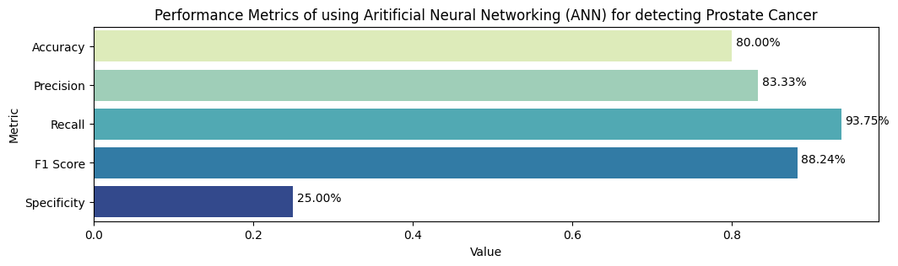
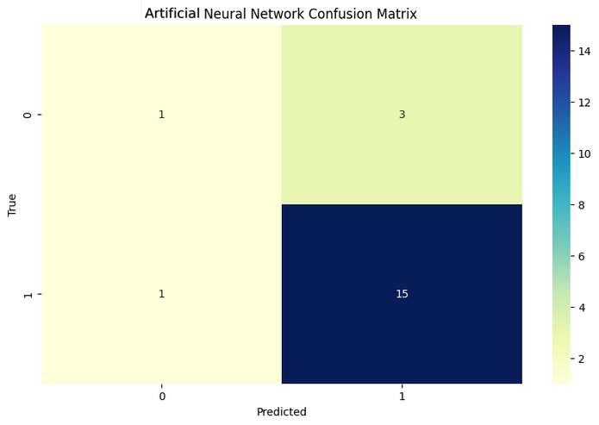
Cancers - PROSTATE CANCER
Model Selection
Artificial Neural Networks (ANN) are good at identifying complex patterns and relationships between features, which can then be generalised on an unseen dataset after training the model. It can adapt to the data provided, optimizing the weights to improve performance.
Preprocessing
MinMax Scaler is used where the features are transformed into a given range
Evaluation
To assess performance, the trained model was evaluated on a test set through a confusion matrix, achieving an accuracy of around 80%, and a recall value of around 93.75%. This indicates the model effectively classified most cases.
Accuracy | Recall | Precision | F1 score
80% | 0.9375 | 0.8333 | 0.8824

Slide 11
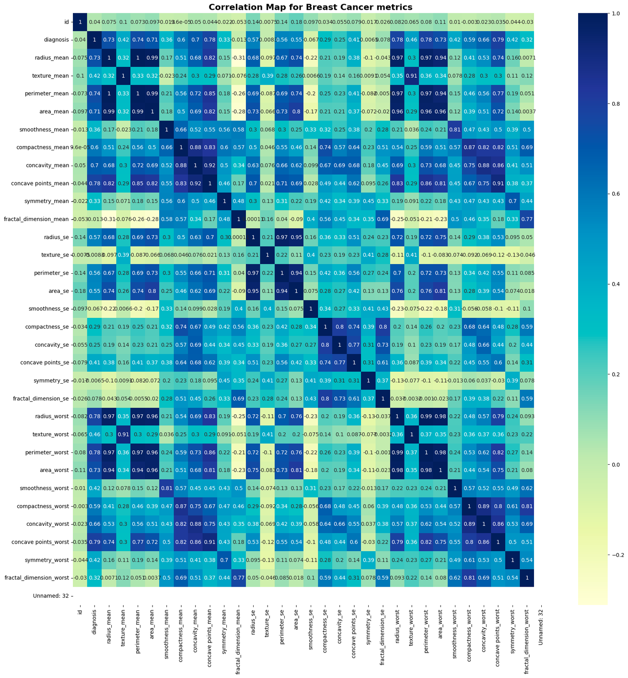
Cancers - BREAST CANCER
Preprocessing
Standard Scaler is used to normalise the data by removing the mean and scaling to unit variance
Model Selection
Logistic Regression is a model designed for binary classification problems, that has a probabilistic interpretation and whose model coefficients can be related to the odds ratios of each predictor. It is computationally simple.
Support Vector Machine (SVM) is a model that finds the largest possible margin that can separate the classes, which results in a good generalisation of test data.

Slide 12
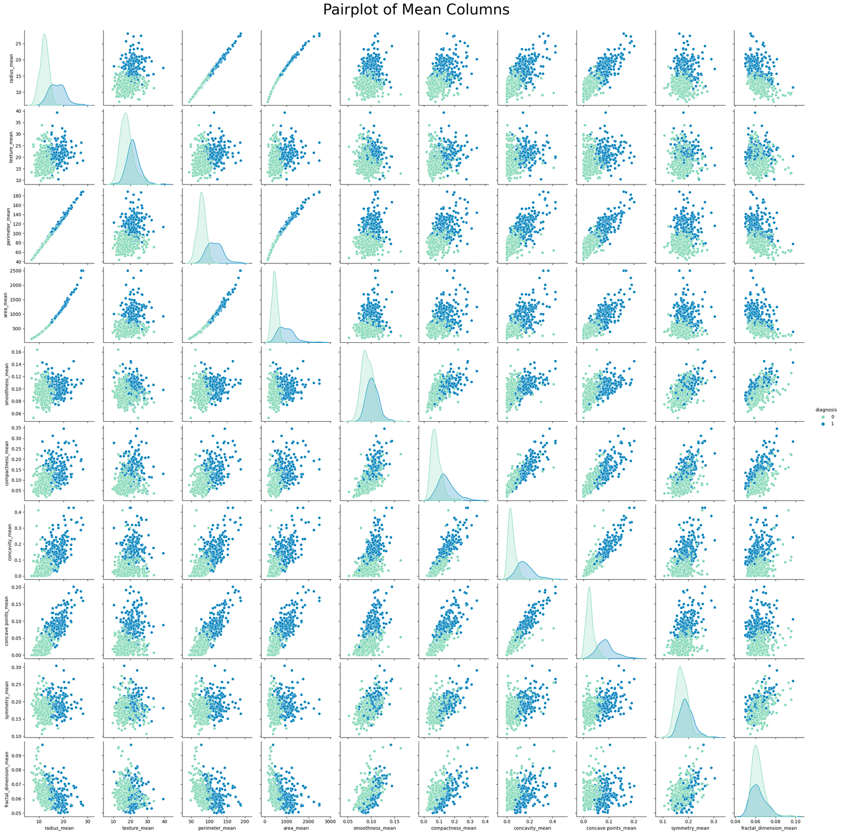
Comparison Result
Summary
We can see from the results that both models work equally well, and both are equally adept at evaluating the possibility of breast cancer
 | Accuracy | Recall | Precision | F1 score
Logistic Regression | 98.25% | 0.9726 | 1.0 | 0.9861
SVM | 98.25% | 0.9726 | 1.0 | 0.9861

Slide 13
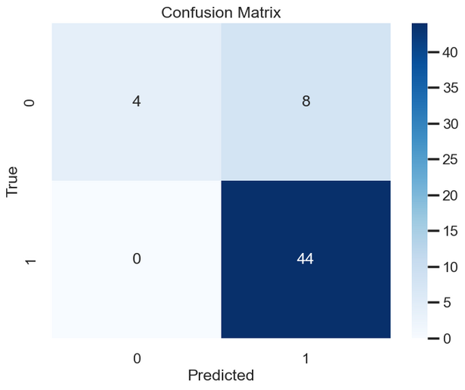
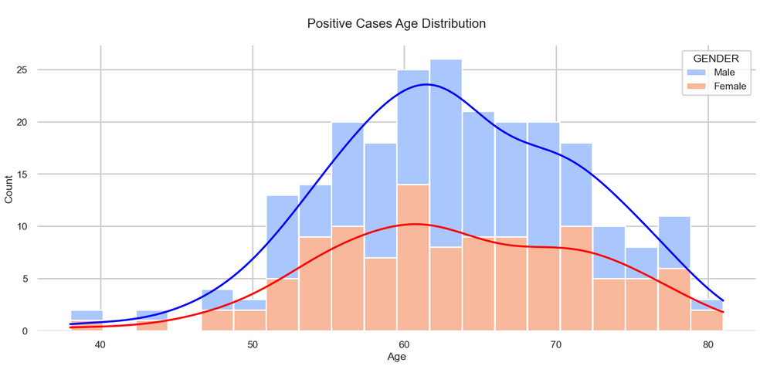
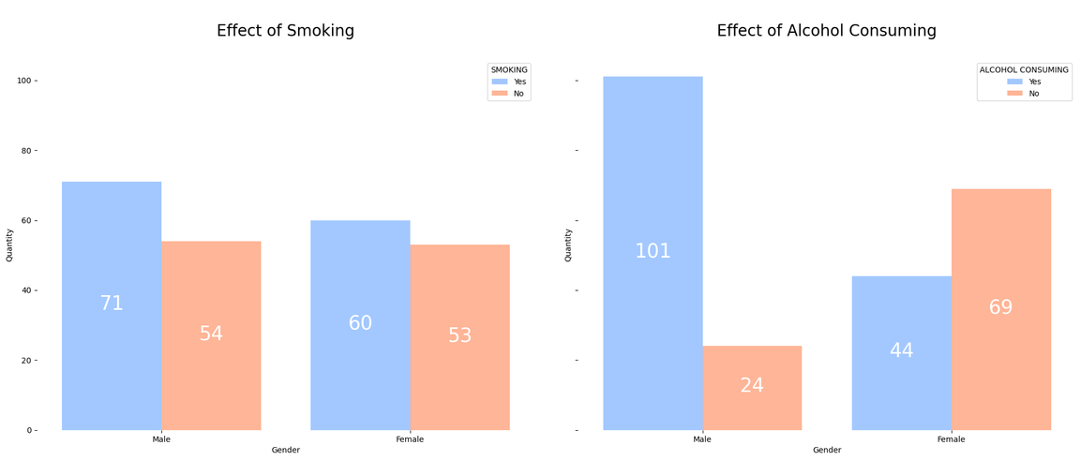
Cancers - LUNG CANCER
Model Selection
Logistic Regression is a computationally simple model designed for binary classification problems, that has a probabilistic interpretation and whose model coefficients can be related to the odds ratios of each predictor.
Support Vector Machine (SVM) is a model that finds the largest possible margin that can separate the classes, which results in a good generalisation of test data.
Neural Network The neural network used here is called a Forward Feed Neural Network, which has a sequential architecture and no feedback loops, which is why it is highly flexible.
Preprocessing
Label Encoder and Standard Scaler is used to transform and normalise the data

Slide 14
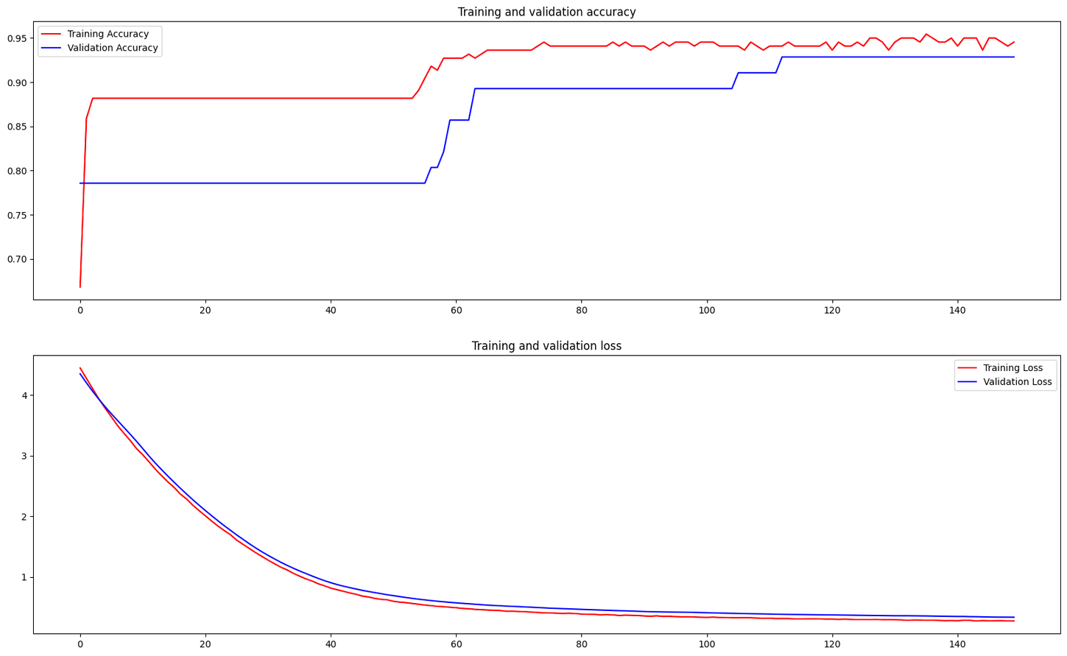
Comparison Result
Summary
From the results, it can be seen that Forward feed neural network is the most accurate in predicting the possibility of lung cancer in patients, with an accuracy value of 92.86%. It excels in all parameters except the recall factor, which shows the success of the algorithm in this classification.
 | Accuracy | Recall | Precision | F1 score
Logistic Regression | 88% | 1.0 | 0.4167 | 0.5880
SVM | 86% | 1.0 | 0.33 | 0.5
Forward Feed NN | approx. 90% | 0.9 | 0.75 | 0.82
Image: Training and validation accuracy
is plotted for 150 epochs

Slide 15
Next steps
Further research with a larger, Irish-specific patient dataset.
Collaboration with healthcare domain experts to refine the model.
Pilot program in a selected hospital to assess real-world performance.
Address data gaps and potential biases for successful large-scale implementation.

Slide 16
References
[1] Noviyanti, C. N., & Alamsyah, A. (2024). Early Detection of Diabetes Using Random Forest Algorithm. Journal of Information System Exploration and Research, 2(1). https://doi.org/10.52465/joiser.v2i1.245
[2] Islam MA, Majumder MZH, Hussein MA. (2023). Chronic kidney disease prediction based on machine learning algorithms. J Pathol Inform. 2023 Jan 12;14:100189. doi: 10.1016/j.jpi.2023.100189.
[3] Barhoom, Ali M. A. et al (2022). Prediction of Heart Disease Using a Collection of Machine and Deep Learning Algorithms. International Journal of Engineering and Information Systems (IJEAIS) 6 (4):1-13.
[4] Bemando, C., Miranda, E. & Aryuni, M. (2021), "Machine-Learning-Based Prediction Models of Coronary Heart Disease Using Naïve Bayes and Random Forest Algorithms", IEEE, , pp. 232
[5] Young, D.L., Engels, R., Colantuoni, E., Friedman, L.A. & Hoyer, E.H. (2023), "Machine learning prediction of hospital patient need for post-acute care using an admission mobility measure is robust across patient diagnoses", Health policy and technology, vol. 12, no. 2, pp. 100754.
[6] Bollepalli, S.C., Sahani, A.K., Aslam, N., Mohan, B., Kulkarni, K., Goyal, A., Singh, B., Singh, G., Mittal, A., Tandon, R. et al., 2022. An optimized machine learning model accurately predicts in-hospital outcomes at admission to a cardiac unit. Diagnostics, 12(2), p.241. Available at:https://doi.org/10.3390/diagnostics12020241
[7] Ghaderzadeh, M., Aria, M., Hosseini, A., Asadi, F., Bashash, D. and Abolghasemi, H., 2021. A fast and efficient CNN model for B-ALL diagnosis and its subtypes classification using peripheral blood smear images. International Journal of Intelligent Systems, [online]
[8] Burrows, N.R., 2017. Incidence of end-stage renal disease attributed to diabetes among persons with diagnosed diabetes—United States and Puerto Rico, 2000–2014. MMWR. Morbidity and mortality weekly report, 66. Available at: https://doi.org/10.24432/C53919
[9] Rubini, L., Soundarapandian, P. and Eswaran, P., 2015. Chronic Kidney Disease. [online] Available at: https://doi.org/10.24432/C5G020
[10] Janosi, A., Steinbrunn, W., Pfisterer, M. and Detrano, R., 1988. Heart Disease. UCI Machine Learning Repository. Available at: Janosi, A., Steinbrunn, W., Pfisterer, M. and Detrano, R., 1988. Heart Disease. [online] Available at: https://doi.org/10.24432/C52P4X
[11] Wolberg, W., Mangasarian, O., Street, N. and Street, W., 1995. Breast Cancer Wisconsin (Diagnostic). UCI Machine Learning Repository. Available at: https://doi.org/10.24432/C5DW2B
[12] Saifi, S. and Mahmood, S., 2017. Prostate Cancer. Kaggle. Available at: https://www.kaggle.com/datasets/sajidsaifi/prostate-cancer
[13] Borkowski, A.A., Bui, M.M., Thomas, L.B., Wilson, C.P., DeLand, L.A. and Mastorides, S.M., 2019. Lung and Colon Cancer Histopathological Image Dataset (LC25000). arXiv preprint arXiv:1912.12142. Available at: https://arxiv.org/abs/1912.12142
[14] Al Aswad, N., 2023. Lung Cancer [Dataset]. Available at: https://huggingface.co/datasets/nateraw/lung-cancer

